Slide 1
Team Coconut Crab
Final Design Presentation

Slide 2
System and Users
An app to monitor and record mass spawning events on Australia’s coral reefs.
Using this app, citizen scientists will upload their observations and photos to a database, allowing scientists to track the timing of mass coral spawning over time, and potentially identify long-term changes in the patterns of mass coral spawning.
The app will be used by diving companies and their clients, resort staff and their clients, and scientists who make a hobby viewing coral spawning.

Slide 3
Home Page

Slide 4
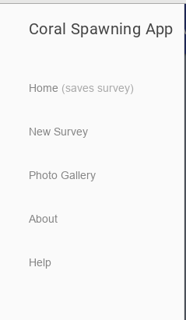
Side Menu

Slide 5
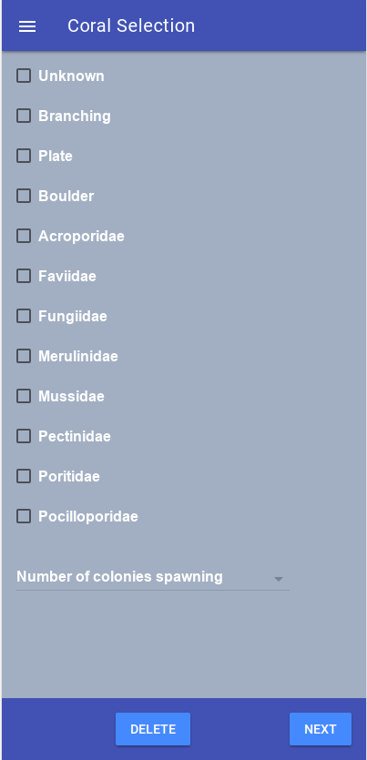
Survey

Slide 6
Example .CSV file

Slide 7
About Page

Slide 8
Remaining components to finish
The survey must include a section to upload photographs
Extra information in survey (i.e. Date / Time, and organization)
On post, update database
Download CSV
Add text to About page and Help page
Revamp home page
Implement a photo gallery
Implement google maps API

Slide 9
Potential Usability Concerns
Might not be mobile friendly
Visibility in high sunlight
Intuitive - easy to use for average people

